Slide 1
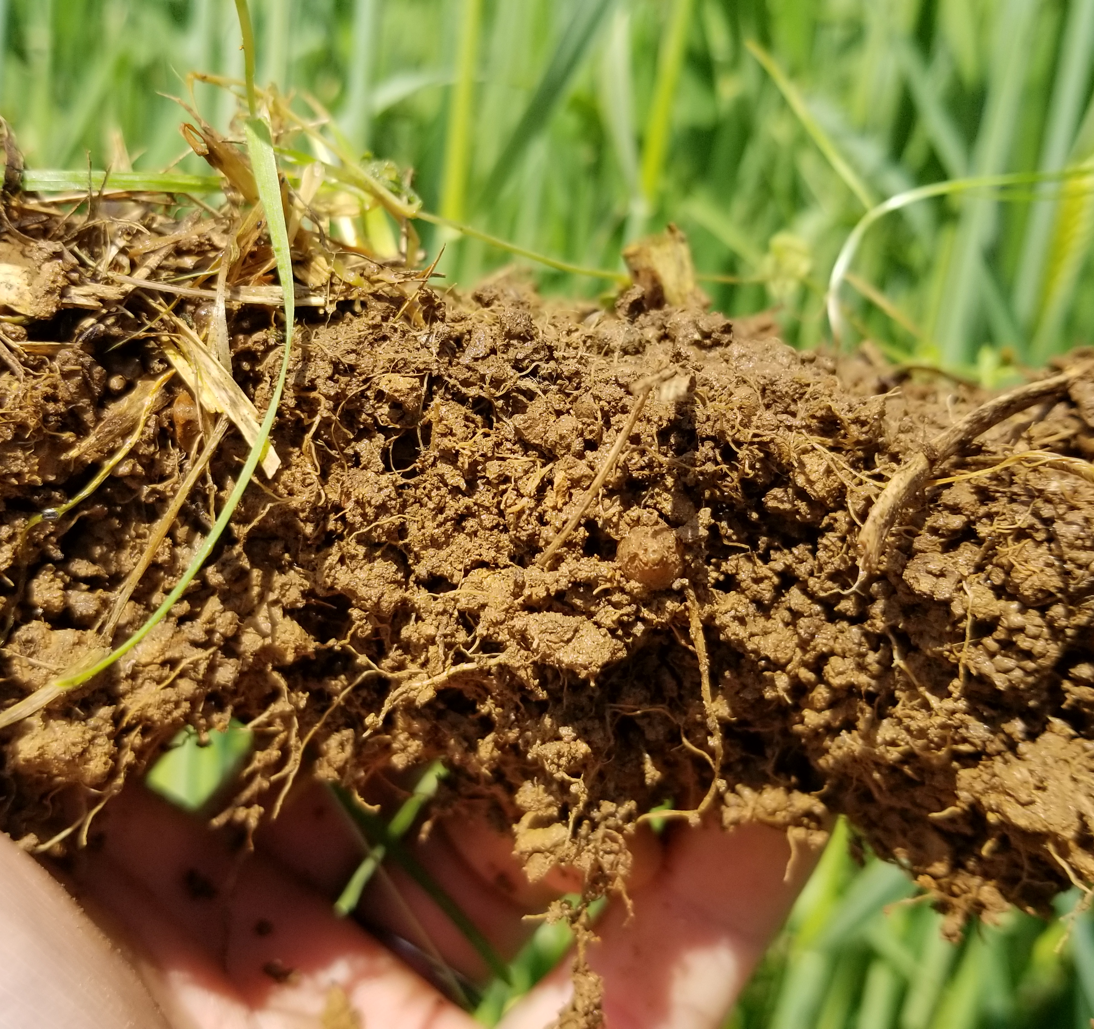
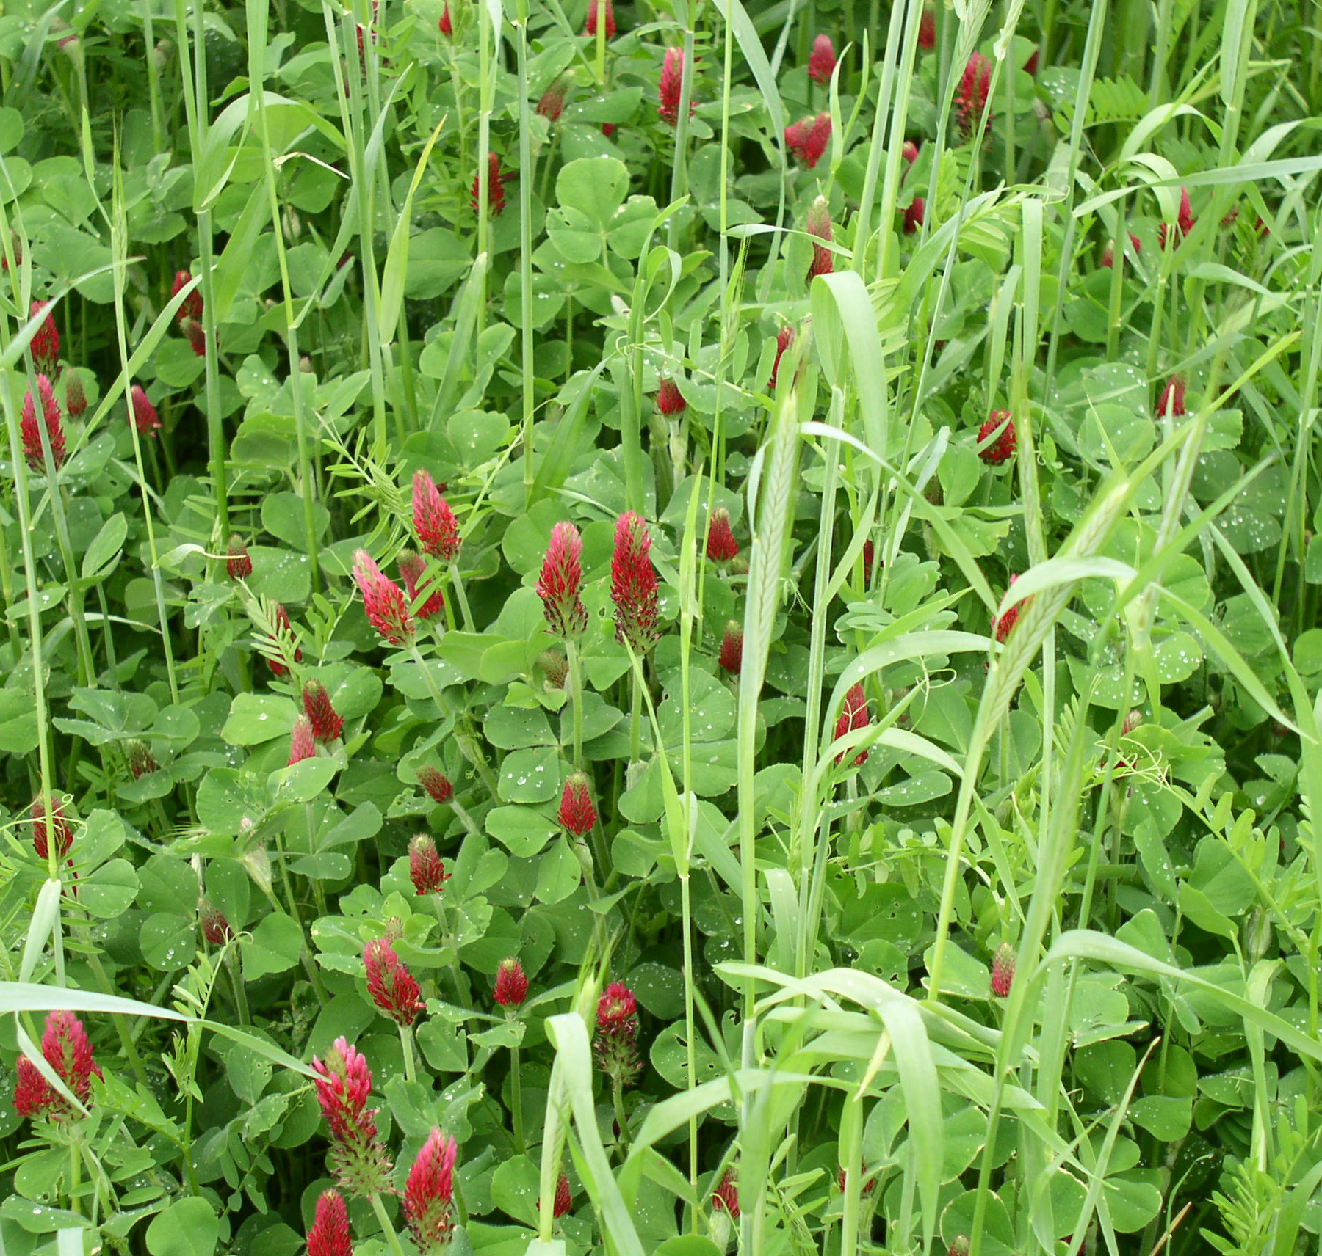


Presenter’s Name
Planning a Cover Crop System
Notes:
Cover crops are a practice to consider when you are looking to implement a SHMS and help meet the SH principles

Slide 2

Objectives
1. Identify priority producer objective(s) and resource concern(s)
2. Identify and select cover crop species to address.
3. Integrating cover crop to compliment current cropping system
4. Cover crop planting logistics
Notes:
Planting/termination methods, the importance of recognizing life history traits, such as phenology/reproductive strategies, growth patterns, moisture requirements and how that’s management is key to understanding how and where cover crops fit within rotation and how to make sure we are mitigating the risks that may be associated with adding a cover crop into a production agriculture system where they might not have been before.
Picture: oats, cow peas, field peas, sunflowers

Slide 3
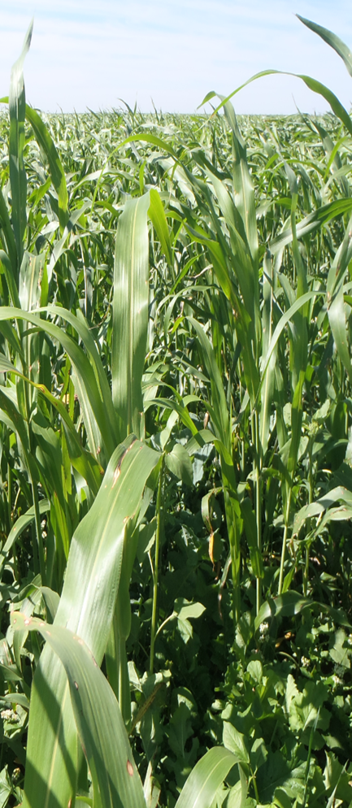
Cover Crop Intentions
Identify Priority Resource Concerns & Producers Objectives
Crop diversity (habitat)
  To support additional biology
  Build or improve soil organic matter
  IPM/beneficial insects
  Livestock integration
  Wildlife winter food & shelter
Notes:
Intention is bold and following bullets are benefits from addressing
Make sure to refer to the purposes in the 340 standard. May have to take out Livestock Integration
.
You may change photo to local representation
Before listing the bulleted points on why we might convince a producer to include cover crops as part of their rotation, have the group chime in on why they might suggest incorporating cover crops into an operation? See how many of these points they can get!
Improve water cycle/availability HUGE purpose in dryland systems. Improve water infiltration, maybe trap and retain snow
C:N-high ratio: can rotate between high and low C:N species within rotation (brassica in corn stalk residue)
Livestock integration: sometimes the only way it is economically feasible to incorporate cc into a dryland system is to get that added revenue stream of integrating livestock into the system.
Photo courtesy of Dan Palic up in NE CO: turnip, forage radish, sorghum sudangrass, oats mix

Slide 4
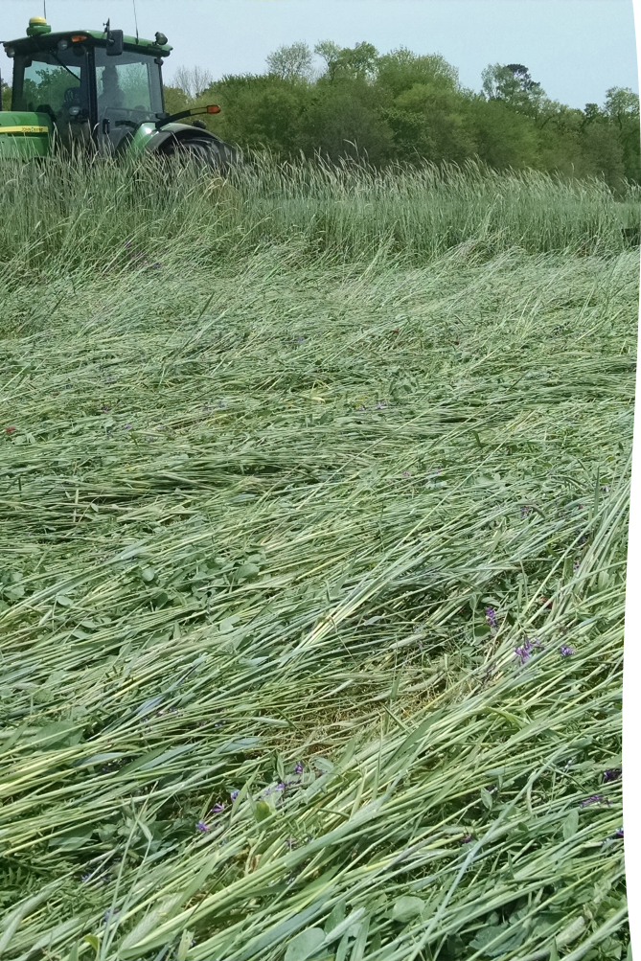
Cover Crop Intentions
Identify Priority Resource
Concerns & Producer Objectives
Soil surface armor (erosion)
  Build stable soil aggregates
  Improve water cycle/ availability
  Weed suppression
  Air Quality
Notes:
Intention is bold and following bullets are benefits from addressing
Photo: Nathan Lowder NRCS

Slide 5
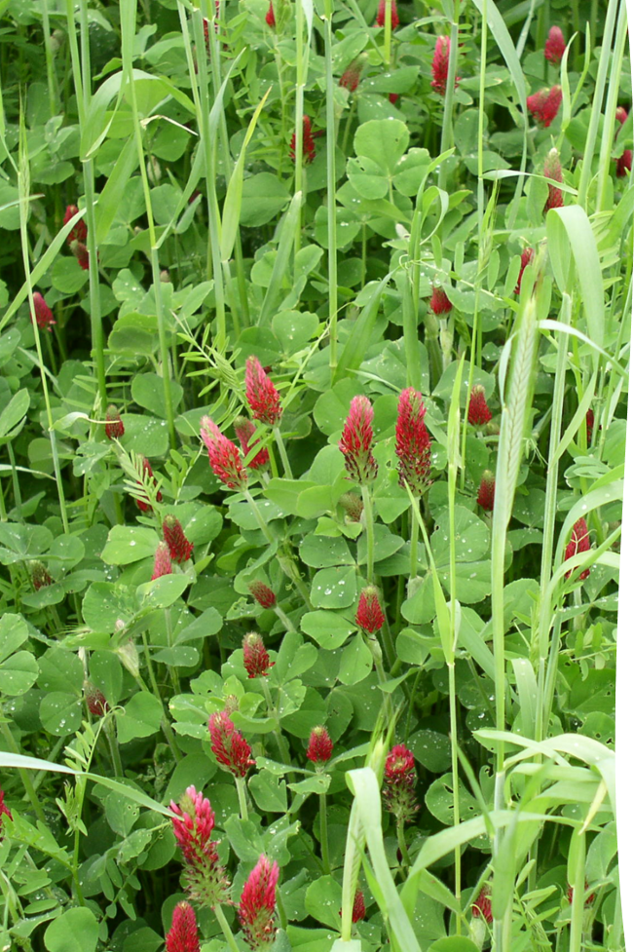
Cover Crop Intentions
Identify Priority Resource
Concerns & Producer Objectives
Nutrient cycling/ efficiency
  Adjust carbon/nitrogen ratios
  N fixation
Notes:
Intention is bold and following bullets are benefits from addressing
Photo: Nathan Lowder NRCS

Slide 6
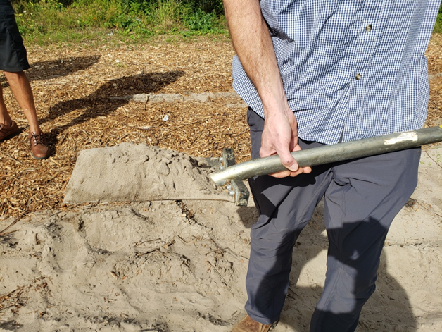
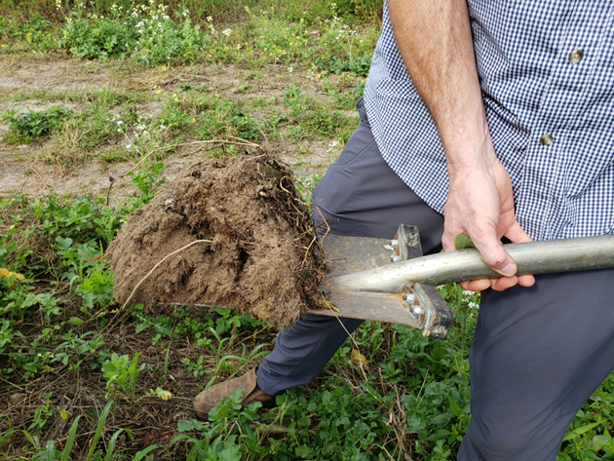
Discuss producers achieved level of transition to SHMS.
  Inventory soil health planning principles
  Determine level of soil function
    IFSHA
    Soil Health Test Results vs. Benchmark
    Changes in cost of production
Notes:
Intention is bold and following bullets are benefits from addressing
It is important as a conservation planner to be able to identify where the producer management level currently is before providing options to achieve a higher level of management that supports soil health. The bulleted items on the slide are a guide or tools that can be utilized to identify that current management.
Photo: Nathan Lowder NRCS

Slide 7
The Nitrogen Dilemma
Nitrogen (N) is the most limiting nutrient for the production of corn. Without sufficient N, yield potential suffers. However, too much N can unnecessarily raise production costs and reduce profit, as well as become a pollutant to the environment. At either extreme, farmers lose out on economic opportunities and may even lose money.
Notes:
Slides 7-14 are results from a study where soil sampling was completed across varying management levels in NC and VA. The sampling was specific to identify Soil Test Biological Activity. Sampling results corresponded to level of need on additional inputs (in this case Nitrogen) in respect to management that was being done on the farm. Results support that where there were managements that supported soil biology, the need of additional inputs lessened as soil biology increased.

Slide 8
How are N Management Decisions Made?
The current assumption is that corn grain requires 1.2 pounds of N for every bushel of grain to be produced. This assumption works for some soils and regions, but data from a recent study conducted on farms throughout North Carolina and Virginia suggests that this assumption of 1.2 lb of N is most applicable for soils pulverized to near death with tillage. It essentially ignores N from organic matter.

Slide 9
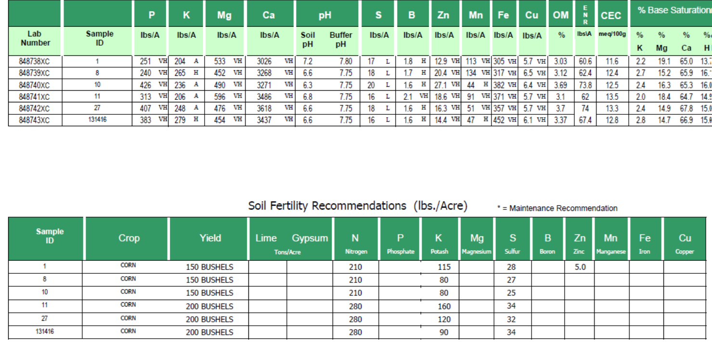
How do we account for a biologically active soil?
Notes:
The slide contains the results from a typical soil sample and also provides recommendations for a future crop. While P and K are measured and recommendations are provided, the recommendation for N comes from a yield goal that was entered by the individual that submitted the sample. Measuring N in the soil has been debated to be very variable and could be in different pools within the soil. The above method does work for systems where soil biology is not a high priority. So producers following managements unlike this are troubled to apply inputs based on a method that has not been tested.

Slide 10

Are there ways we can test for this?
Notes:
We will look at work that has been completed by Dr. Alan Franzluebbers

Slide 11
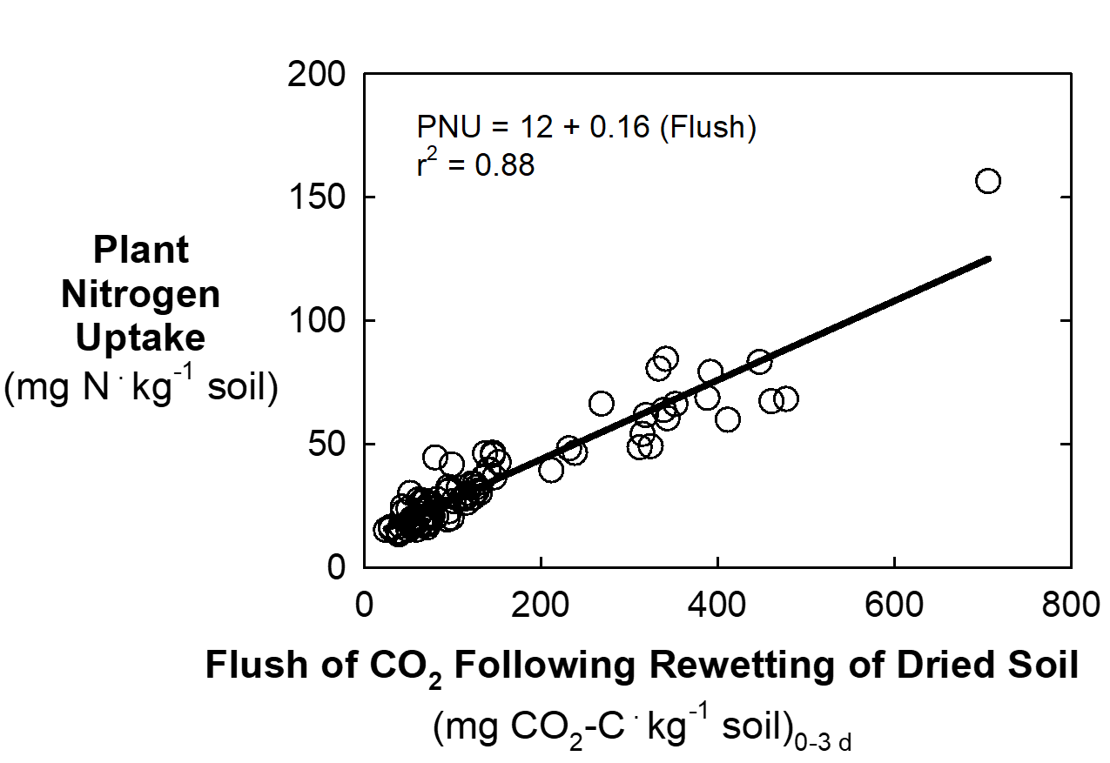
Plant N uptake in strong relationship with the flush of CO2
Soil from 30 sites in NC + VA
(0-10, 10-20, 20-30 cm depths each)
Pershing (2016) NC State University MS thesis

Slide 12
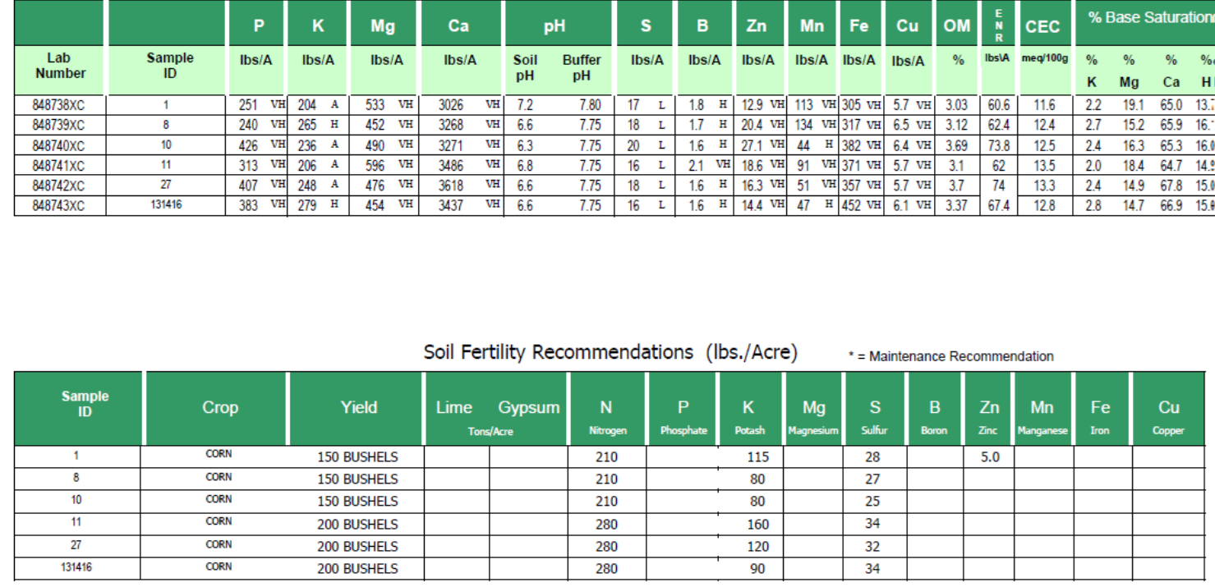
How do we account for a biologically active soil?

Slide 13
Intensity of yield response to N fertilizer
Total of 36 fields in NC + VA
Pershing (2016) NC State University MS thesis

Slide 14
Adjustment of N per bushel of grain
Total of 36 fields in NC + VA
Pershing (2016) NC State University MS thesis

Slide 15
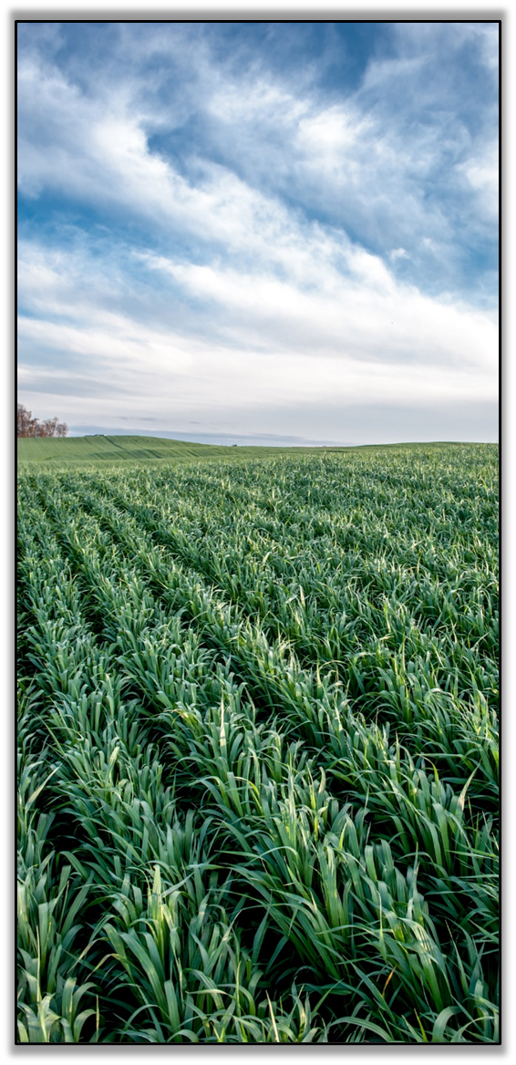
Cover Crop Considerations for Successful Planning
Site preparation
Early weed control
Timing and species (adequate growing season)
Crop rotation/diversity
Seed quality (bin run, PLS, certified)
Seeding method seed-soil contact (broadcast vs. drilling)
Seed size/seeding depth
Legume inoculation
Moisture management (cover benefits, water use)
Producer’s goals
Notes:
You may change photo to local representation
Spend a little more time explaining as needed, as these are not explained in more detail later in the presentation:
Site preparation: same for all conservation seedings, need good seed to soil contact, ask questions like how much residue will you be planting into, what equipment does the producer have for seeding/terminating? Drill vs broadcast, will you be planting into a growing crop? How much moisture is available for my mix? Are the weeds adequately controlled? will there be any herbicide carryover that could affect cover crop?
Early weed control: get the cc in as early as possible to eliminate weed pressure
Crop rotation/diversity: consider incorporating all the plant functional groups into your rotation where possible. Understand that the more diverse the mix is, the harder it can be to manage. Consider combinations of cover crop mixes to achieve more objectives, however it is more cost effective to limit mixtures to species that will reliably achieve objectives than to try too many species at once. Can be a common misconception, sometimes a really well-developed mix that has 3 species is much more successful (and economically feasible) then a mix that has 17 different species

Slide 16

Identify Current Cropping System
May be a monoculture crop or series of crops that are part of a rotation. Examples
  Corn, Soybeans
  Corn, Wheat, Double Crop Soybeans
  Cotton, Cotton, Peanuts
  Continuous cotton or corn
  Vegetables
Identify periods that do not contain cash crops
Assess producers' intentions, seeding windows and that growing season is adequate
Notes:
*****Find document that has typical rotations from across the US ask Marlon and Nick
*** Add Candy’s excel spreadsheet in the chat to identify windows
**Add local examples of seeding windows. When can the producer plant CC in his rotation? The easiest in most rotations is behind small grain crops.
Be aware of crop insurance implications, they seem to be a constant moving target
There may be short windows to grow cover crops ex. 60 days between cash crops to build diversity, scavenge nutrients, and suppress weeds.
These are the four major opportunities to seed cover crops in traditional cropping systems.

Slide 17
Develop Mix to Compliment Next Crop
Experienced SHMS producers can get very detailed. Producers may select specific species ahead of certain crops
  Example rotation: 2 yr. rotation - Corn, Soybean
    Cover crop prior to corn
      - CS mix that favors legume component
      - Include grasses and broadleaf plants
    Cover crop prior to soybean
      - CS mix that favors grass component
      - Include broadleaf plants
Notes:
Experienced SHMS producers can get very detailed. Producers may select specific species ahead of certain crops. Slides 17-22 will look at example rotations that a conservation planner may observe of producers in their area. Note: if these example rotations do not fit your area, feel free to substitute in new rotations for these slides. The exercise is to identify the cash crops in the rotation and then select the appropriate cover crops to compliment the system. There could be considerable differences from state to state even though the rotation may be the same. Instructors: Know your audience and make these applicable to your audience.

Slide 18
Develop Mix to Compliment Next Crop (2)
  2. Example rotation: 2 yr. rotation - Corn, Wheat, DC Soybean
    Cover crop prior to corn
      - CS Mix that favors legume component
      - Include grasses and broadleaf plants
    Cover crop prior to wheat
      - WS mix containing equal components
    Cover crop prior to soybean
      - CS mix that favors grass component
      - Include broadleaf plants

Slide 19
Develop Mix to Compliment Next Crop (3)
Select specific species ahead of certain crops
  3. Example rotation: 3 yr. rotation - Cotton, Cotton, Peanut
    Cover crop prior to cotton
      - CS mix containing equal components
    Cover crop prior to cotton
      - CS mix containing equal components
    Cover crop prior to peanuts
      - CS mix that favors grass component
      -Include broadleaf plants

Slide 20
Develop Mix to Compliment Next Crop (4)
Select specific species ahead of certain crops
4. Example crop: monoculture cash crops – Continuous Cotton or Corn
    Cover crop prior to cotton each year
      - CS mix containing equal components
    Cover crop prior to corn each year
      - CS mix favoring legume component
      - Include broadleaf plants

Slide 21
Develop Mix to Compliment Next Crop (5)
Select specific species ahead of certain crops
  5. Example rotation: 4 yr. rotation – Vegetable (tomato, pumpkin, green bean, onion, ect.)
    Cover crop prior to legumes
      CS mix favoring grasses
    Cover crop prior to root crop
      - CS mix containing equal components
    Cover crop prior to fruit
      - CS mix containing equal components
    Cover crop prior to leaf crop
      - CS mix containing equal components

Slide 22
Develop Mix to Compliment Next Crop (6)
  6. Are there other options???????
    Regional variations may allow for
      Short season covers
      Inter, companion, relay cropping options
Notes:
Engage with the course participants to have a discussion about other options. Ask course participants if they are working with producers that are integrating cover crops in innovative ways.
Ex. South Carolina producer harvest corn in mid to late August. There is nearly three months before a killing frost will occur. Herbicide resistant weeds will have a huge opportunity to grow and produce seed. Current recommendation is to perform multiple passes of a herbicide to control herbicide resistant weeds. This producer instead plants a warm season cover crop to suppress weeds and build nitrogen ahead of cool season cash crop of wheat. Even though there is only three months between cash crops, during this time cover crops become established quickly and can provide a lot of biomass accumulation. The cover crop can be terminated with a herbicide or frost before wheat planting.

Slide 23
Find the Right Variety
Specific priorities and resource concerns may require specific varieties
Cropping systems may only provide small windows
  Corn – usually planted early
    - Early maturing legumes needed to justify expense
    - Source AU and other early maturing varieties
  Soybean – earlier planting dates increasing
    - Source early maturing grasses and broadleaf plants
    - Cover Crop Councils and PMC’s collaborated to conduct small grain variety trials
      Useful info for variety selections
Notes:
Dependent on producer objectives and identified resource concerns, there may only be a small window to include a cover crop. Careful selection of specific varieties could assist in filling these gaps while addressing both producer objectives and resource concerns.

Slide 24
The Time to Plan is Now!!!!
  If planting early
    Understand expected residue accumulations and lasting cover
    Assess cash crop planting date to fulfilling the desired objective
  Early varieties can be hard to source
    Just because the variety has been released doesn’t mean it is in full production
    Much of the cover crop seed is grown and sourced from the Northwest US and imported in.
    As cover crop interest increases, producers may be able to capitalize on adding additional cash crops that will be used as cover crops
Notes:
If planting early
Understand expected residue accumulations and lasting cover – cover crops terminated early will have a lower C:N ratio resulting in residue decomposing faster during the crop season
Assess cash crop planting date to fulfilling the desired objective – Ex. If nitrogen fixation is the producer objective, terminate cover crop at 50% bloom, terminating earlier will significantly affect the amount of nitrogen produced.

Slide 25
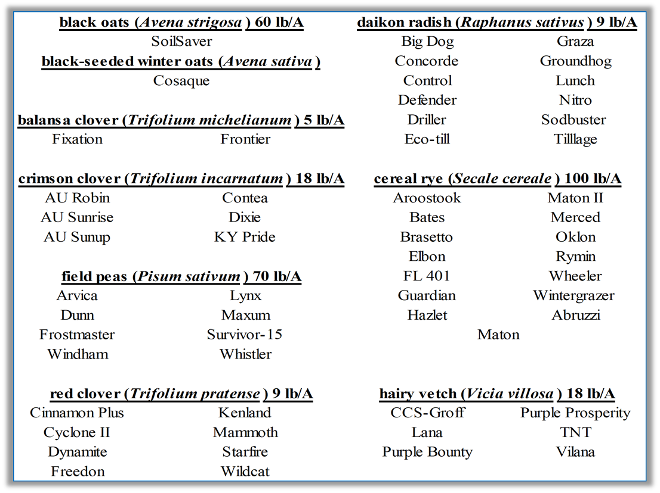
Cultivar Variations
Notes:
Can be critical depending on the species.
Especially if you are seeding annual ryegrass, ensure that you know the variety. Some species are extremely difficult to terminate.
If you have a variety that is identified, you are making a more informed decision and you have a better understanding of how that plant will behave which leads to better management and helps you meet your objectives.

Slide 26





Selecting the Right Seeding Mix
Utilize available planning tools
Start with state specific resources
Plant Materials Centers
Cover Crop Council Tools
  Cover Crops Decision Tool (MCCC)
  Species Selector Tool
  Cover Crop Explorer
  Cover Crop Nitrogen Calculator
Industry resources
Others
Notes:
There are several different tools for use when selecting cover crops. Here are several that could be utlilized. NRCS currently does not have an official tool to plan cover crops and rely on each states 340 conservation practice standard and supporting documents. These and other listed tools may be useful in different regions of the US.

Slide 27
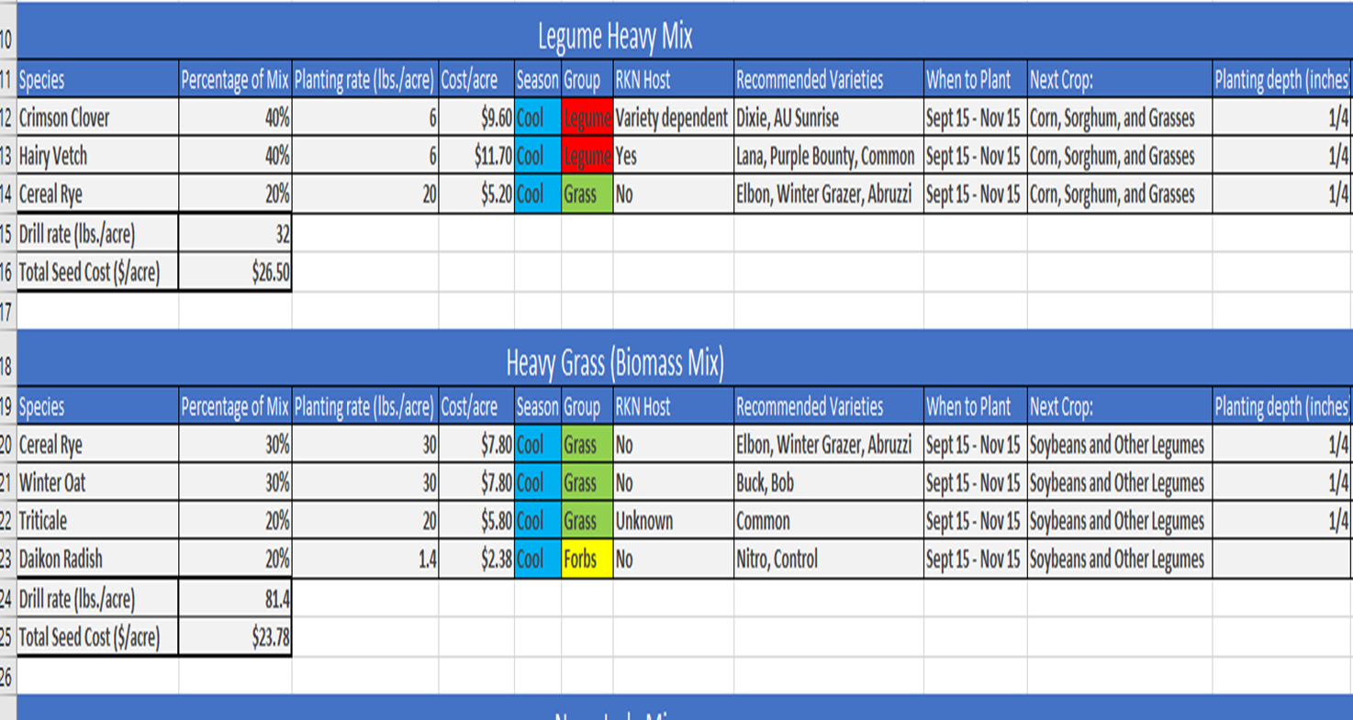
Seed Mix Calculators https://efotg.sc.egov.usda.gov/api/CPSFile/30421/
Notes:
USDA NRCS seeding rate calculator example. This was completed by the NRCS Plant Materials Program.

Slide 28
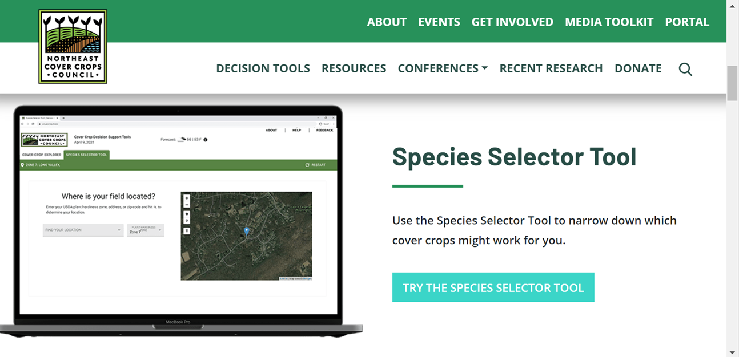
1
Notes:
Cover Crop Planning Resource from the Northeast Cover Crop Council

Slide 29
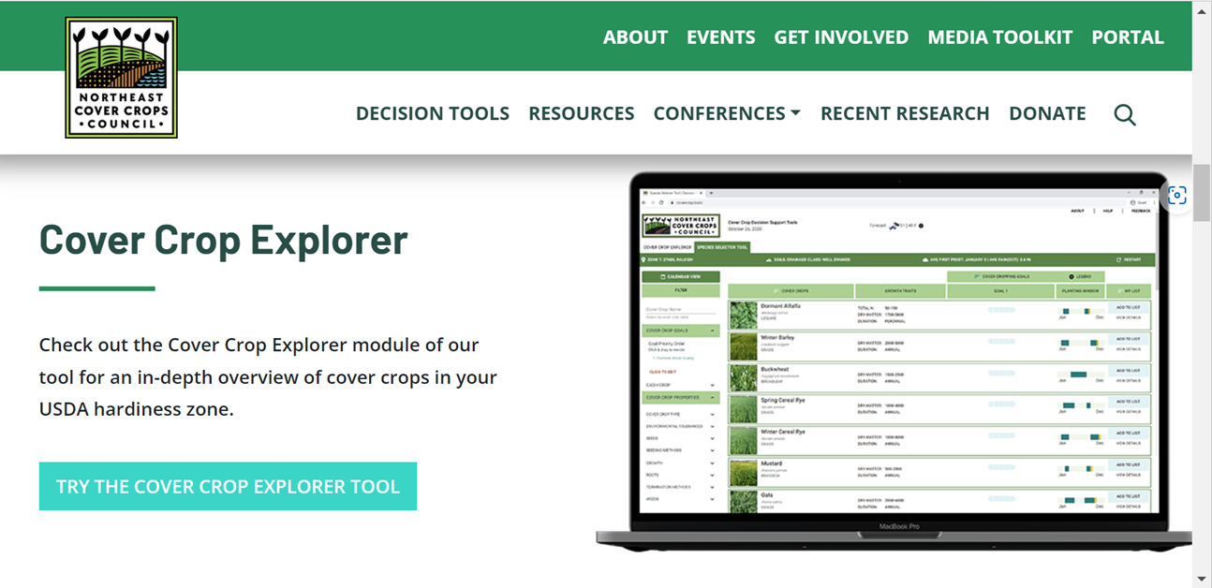
2
Notes:
Cover crop planning resource from Northeast Cover Crop Council

Slide 30
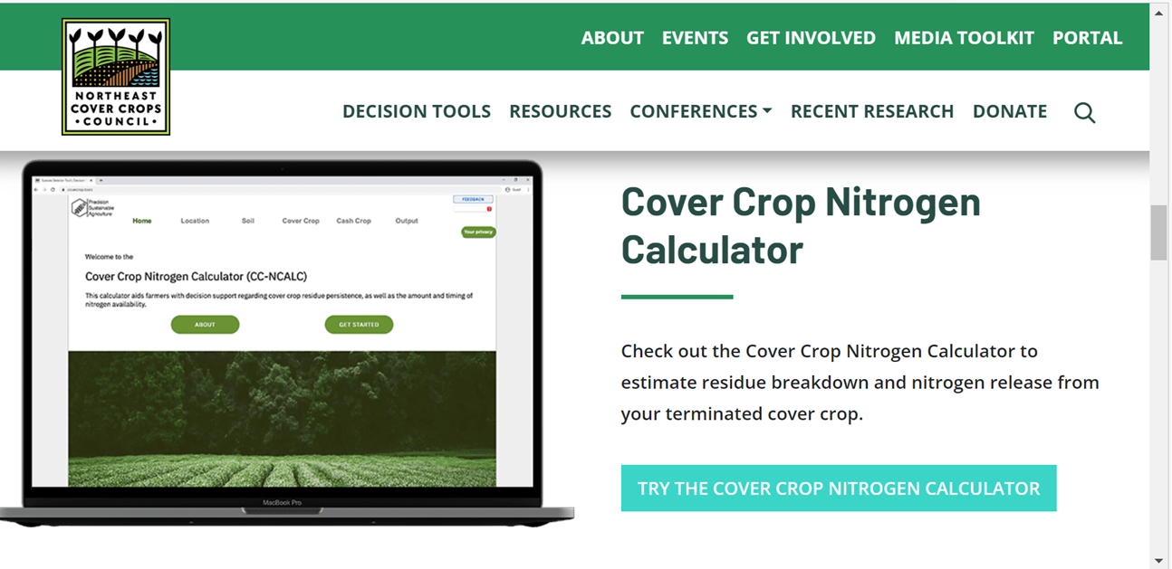
3
Notes:
Cover crop planning resource from Northeast Cover Crop Council

Slide 31
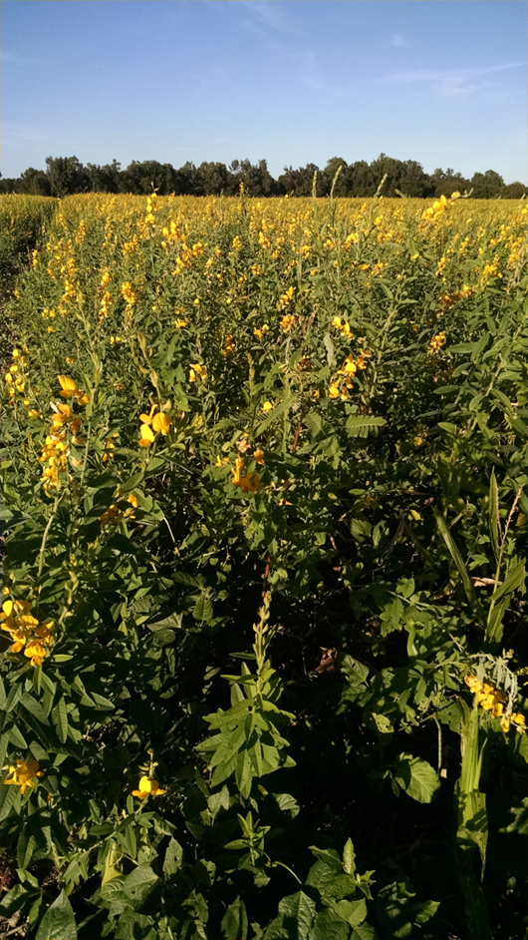
Assess and Select Species
Characteristics should address identified priorities and resource concerns
Growth cycle
Growth habit
Root architecture
Growth rate
Chemical composition
Stress tolerance
Time to flowering
Pest resistance or susceptibility
Notes:
Photo: Nathan Lowder NRCS
Growth Cycle- Perennial, Biennial, Annual?
Above ground- (erect, viney, spreading, single/multi-stemmed, height, leaf character)
Root architecture- (tap, fibrous, rhizomatous, depth)
Rate of growth- (also differs by growth stage i.e. seedling vigor)
Chemical composition- (allelopathy C:N ratio, root exudates) oats accumulate more N than triticale/ millets have no prussic acid compared to sorghum sudangrass.
Tolerance to stress- (drainage, pH, shade, low fertility)
Time to flowering- (termination or self seeding issue) caution Mustard and buckwheat species flower very quickly within 60 days.
Pest resistance or susceptibility

Slide 32
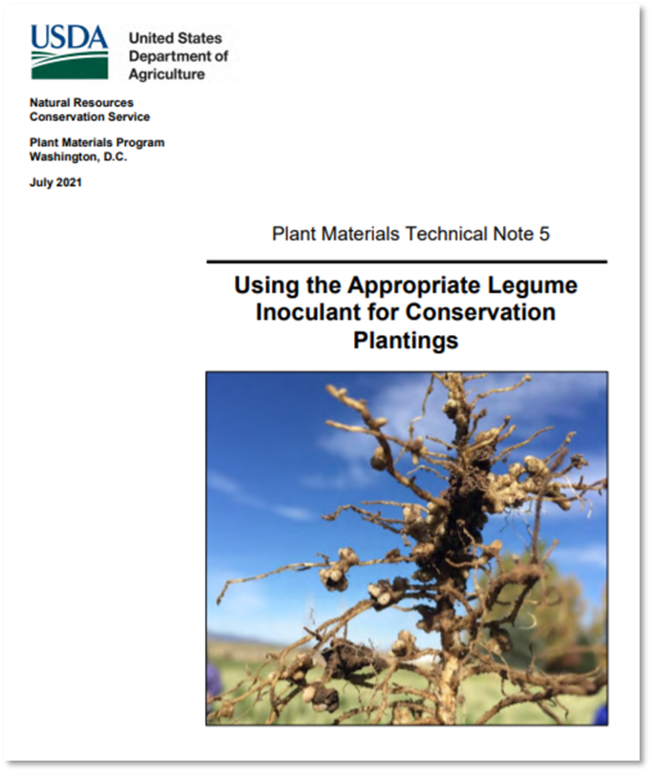
Need for Legume Inoculation
Inoculants help guarantee the successful formation of nitrogen-fixing nodules in legumes
Inoculants are species specific
Inoculants are alive and have a maximum storage life
Keep inoculant refrigerated out of direct sunlight and
Use prior to expiration date.
Notes:
USDA NRCS Plant Material Tech Note 5: Using the appropriate legume inoculant for conservation plantings. Great concise publication that is full of information including tables that help match the species specific rhizobia with common legumes.
When root hairs find a compatible bacterial match they encircle the bacteria to create a nodule
The pinkish interior of the nodule are visible sign that nitrogen fixation is at work.
The bacteria contribute an enzyme that helps convert the N2 gas from the atmosphere to ammonia NH3
High nitrogen concentration in the soil from fertilizer of manure inhibits nodulation
Plant can contribute up to 20 % of its carbohydrate production to the bacteria
N fixation peaks at flowering
These bacteria remain viable in the soil for 3 to 5 years

Slide 33
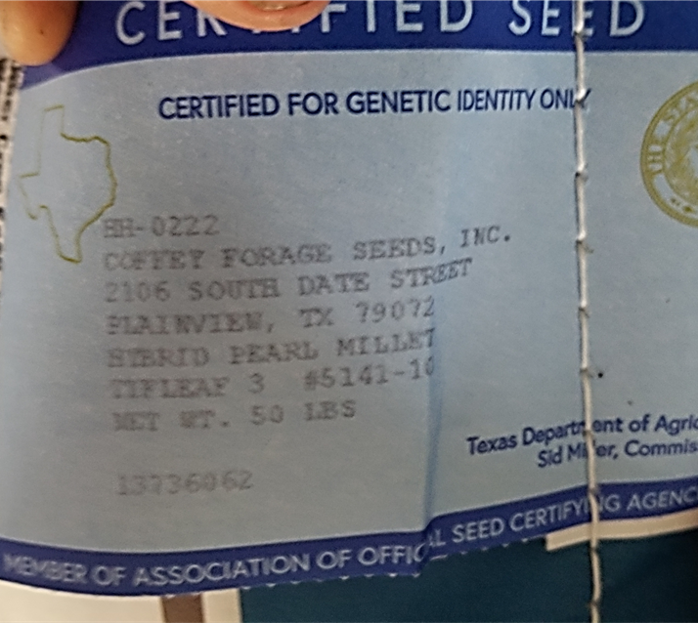
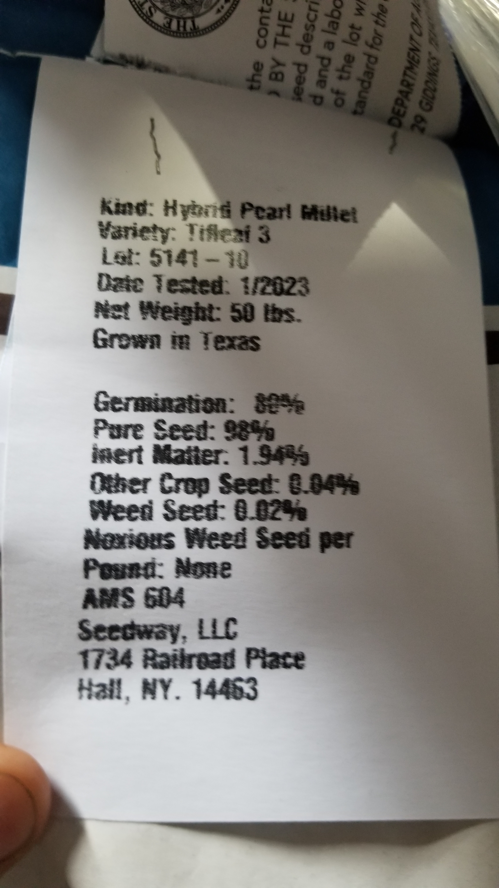
Certified Seed
% Pure Live Seed (PLS) = (% Germination + % Hard Seed)(% Purity)/100
% PLS = (80 + 0)(98)/100
% PLS = 78.4
Notes:
Photo: Nathan Lowder NRCS
Seed tag information PLS purity of seed coating 34% inert, Hard seed information 10% germination.
Certified vs VNS
VNS is cheaper may not know the adaptability important for some species.
Certified expensive important for some qualities usually better-quality seed due to higher requirements. Can’t get new varieties of cover crops if not willing to buy certified seed.
Note: State seeding specifications vary. Confirm in the CPS 340 and supporting documents to determine if seeding rates are PLS or #/acre.

Slide 34
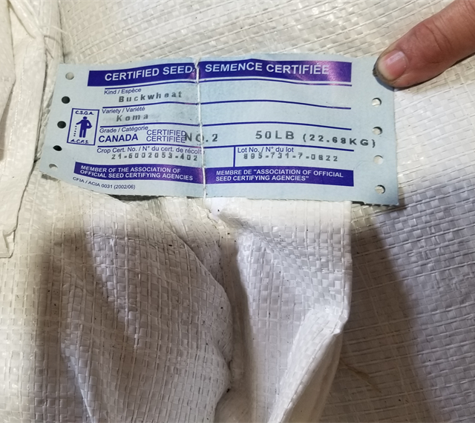
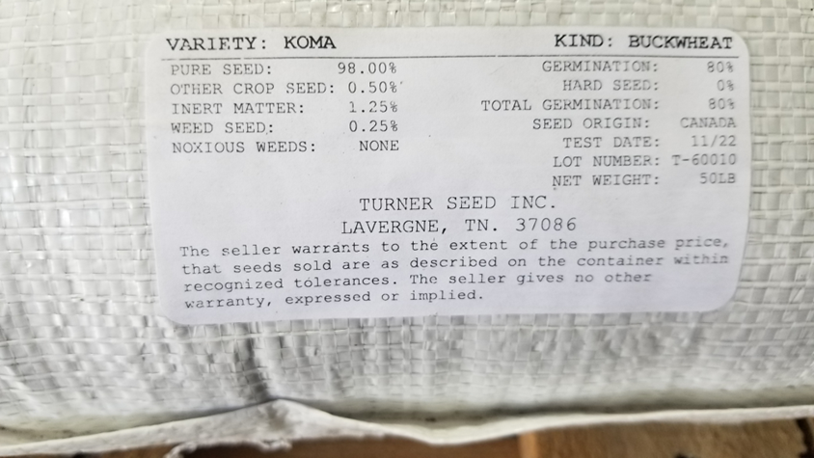
Certified Seed (2)
% Pure Live Seed (PLS) = (% Germination + % Hard Seed)(% Purity)/100
% PLS = (80 + 0)(98)/100
% PLS = 78.4
Notes:
Photo: Nathan Lowder NRCS

Slide 35
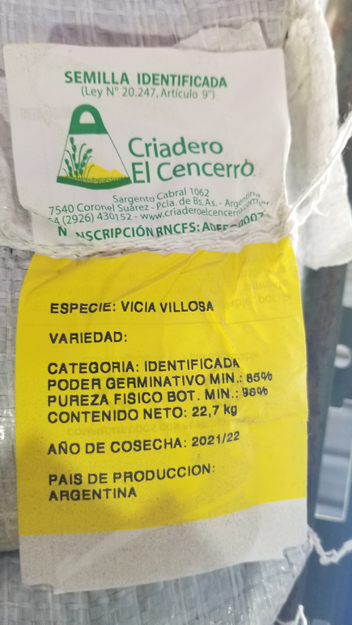
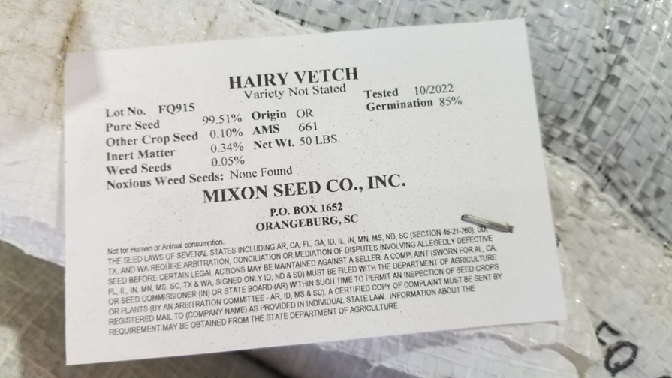
Seed that is VNS
Variety Not Stated
% Pure Live Seed (PLS) = (% Germination + % Hard Seed)(% Purity)/100
% PLS = (85 + 0)(99.51)/100
% PLS = 84.5
Notes:
Photo: Nathan Lowder NRCS

Slide 36
How will you seed it?
Drill
Aerial Broadcast
Ground Broadcast
Tillage Pass
Spring cover crop termination management
  Timing termination to allow for reseeding
Notes:
In the SHAS course we went into detail of numerous ways producers may get cover crops seeded.

Slide 37
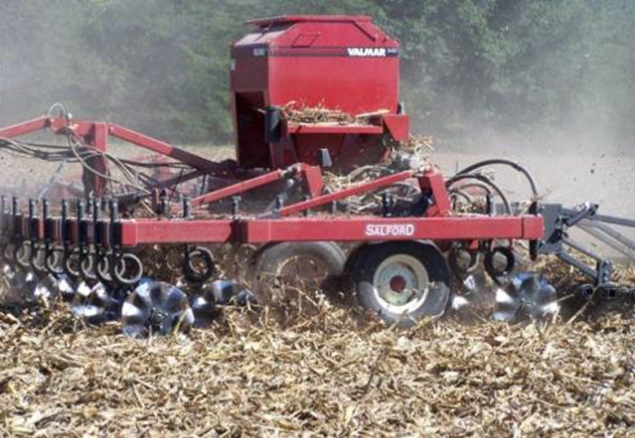
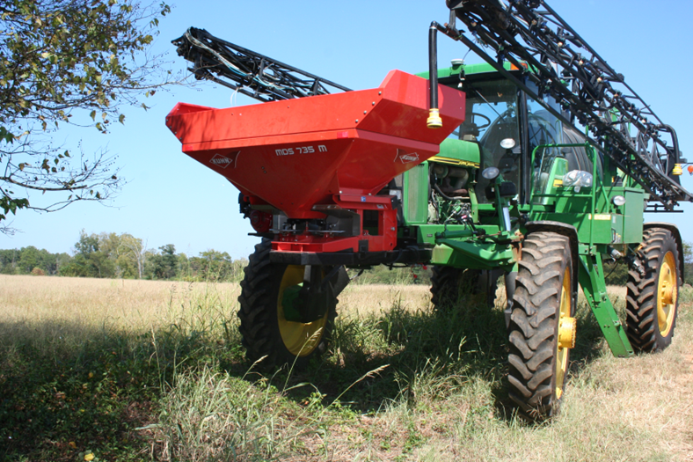
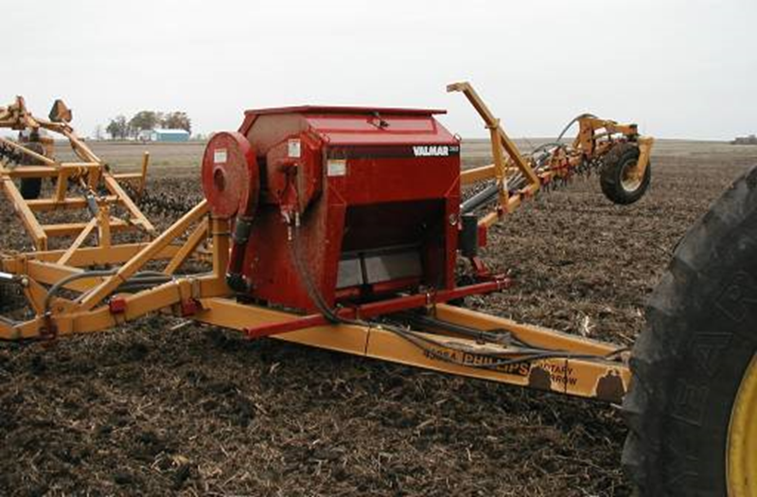
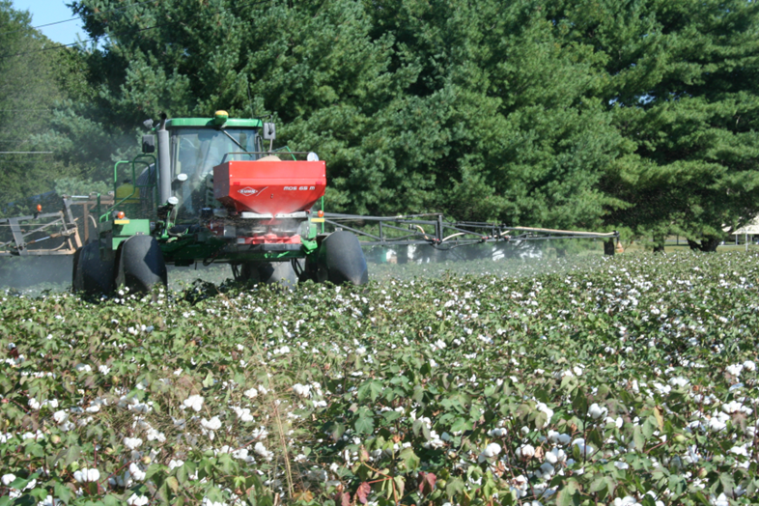
How will you seed it? (cont)
Minimize field passes
Combine other operations
  Residue management
  Fertility or amendment inputs
Notes:
Photo: Nathan Lowder NRCS
Air seeders mounted on vertical tillage tools or rotary harrows may have many advantages over broadcasting alone, particularly if the farmer already owns the equipment. An air seeder could be mounted on the vertical tillage tool ( why did you have sprayer that would be more for into standing crop?)
Seed can also be blended with fertilizer or pelletized lime and broadcast ahead of the incorporation tool for best results. Sometimes spread after, but not recommended ( best if can be timed just ahead of a rain)
Cost estimates for operation provided by Iowa State 2018 Custom Rate Survey excluding seed
https://www.extension.iastate.edu/agdm/crops/pdf/a3-10.pdf

Slide 38


New and Upcoming Technology
Drones
  Ability to apply liquid and solid products with change of onboard equipment.
  Commercial or producer applications
  Lots of state and national specific regulations
    Permits
    Licenses
Notes:
Update photos

Slide 39
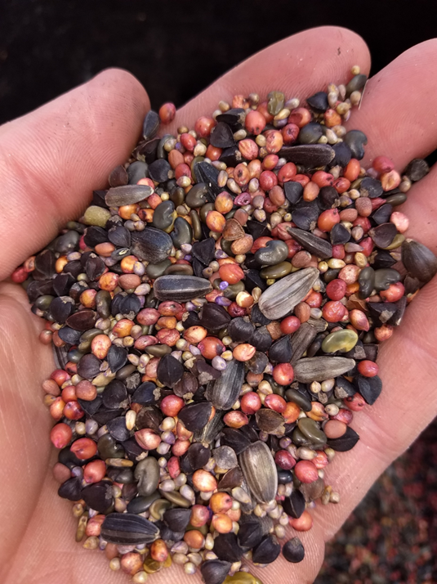
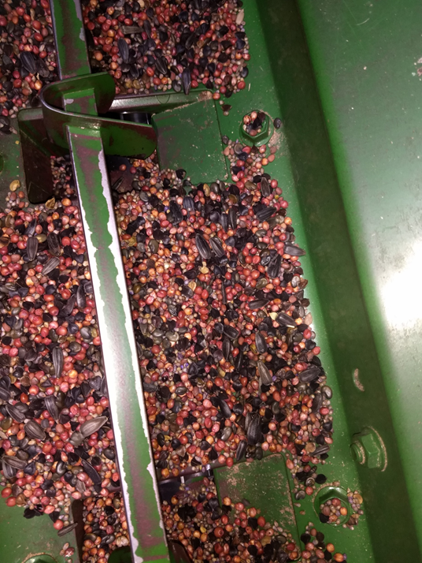
But how do I plant a mix?
Concerns:
Mix settling out
  Diverse seed sizes provide mix stability
Undesirable planting depth
  Select seeding depth based on shallowest species
  If using multiple seed boxes, observe seed delivery at openers.
Broadcast pattern not uniform
  Select track spacing to seed with lowest density
  Apply seeding stickers to aggregate seed
Notes:
Photo: Nathan Lowder NRCS
This slide addresses common issues or questions about planting cover crop mixes. The first picture is of a common warm season mix containing sunflower, sunn hemp, sorghum, millet, buckwheat that is being loaded into a box drill. The second photo is after a majority of the seed has been planted exposing the bottom of the box drill. Notice that all species are still present in the mix. It is thought that the more species that are in a cover crop mix that the more stable the mix due to different seed sizes filling all voids.

Slide 40
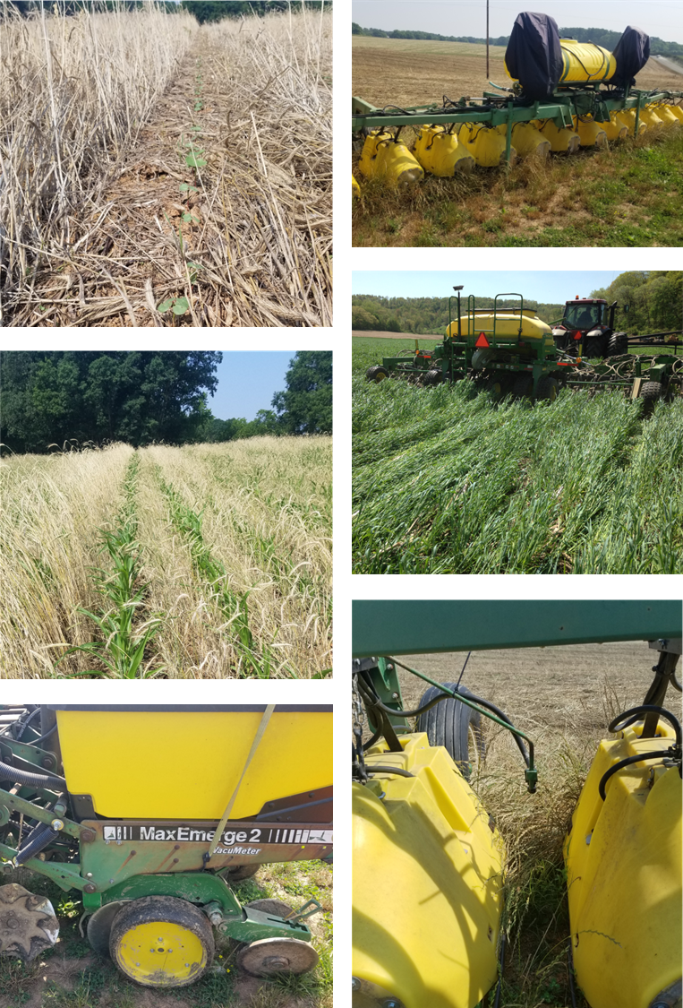
Planting Green
Advantages:
increased biomass for weed control
better planter performance in standing cover vs a thick mat
more biomass reduces evaporation and erosion
Disadvantages:
increased pest pressure
more risk of wrapping on planter drives and wheels; hairpinning
pollen shed plugging breathers or air flow devices
over utilization of moisture.
Notes:
Advantages: Maximizes photosynthesis opportunities enabling the improving the carbon cycle. Cover crops can be managed to remove excess moisture in wet seasons.
Better planting performance in standing residue vs. residue already on the ground due to issues with coulter or disc opener problems cutting through the residue – hairpinning can occur (pushing residue down into the seed trough and interfering with seed placement).
Disadvantages: These are commonly seen WHEN producers attempt to plant in dying cover crop residue. During this time residue becomes very tough and rubbery creating less than optimal conditions for planting. Green fresh residue or brown crispy brittle residue are desired conditions to avoid some of the listed disadvantages dealing with equipment.
Photo Center Right: In the pictured example, the producer is planting green and will followed up with herbicide application to terminate cover crop
Planting green is not the same with every producer nor is every cropping season. Producers will find that flexibility is key to a successful SHMS.
Photo Top Left: Emerging cotton planted green. Cover crop was terminated after planting
Photo Top and Bottom Right: Producer utilizes a hooded sprayer to terminate cover crop in a band over the row. Cover crop under the hood is not sprayed and is allowed to grow later to address producer objectives. Terminating the band over the row allows producer to plant into less residue and allows for better crop establishment with small seeded or finicky cash crops.
Photo Center Left: Corn growing in cover crop that was terminated at planting and left standing.
Photo Bottom Left: Typical notill planter set up.

Slide 41
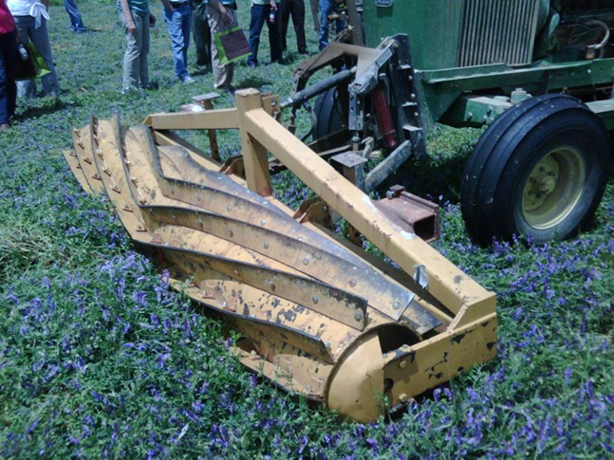
Cover Crop Termination Methods
Herbicide burn down
Frost termination
Crimper / Roller
Grazing– Not in Term Guidelines
Shredding / mowing
Tillage
Combination of methods
Notes:
Order of success of termination
This is a topic that usually raises a lot of questions. There are many ways to terminate cover crops and a lot will depend on the climate of the area and the objective of the producer. There are many variables when considering termination methods. Instructors should be able to discuss examples of where each method could and may be used. Be aware of crop insurance guidelines.
Frost termination: used in climates where temperature falls below ideally growing conditions for cover crop species and kills crop
Crimper/Roller: Can be used in independently or as combination. To be used independent, crimper/roller must snap, crimp, or break vegetation stems to stop flow of nutrients throughout the plant. Must be completed when target species reaches early maturity before viable seed.
Herbicide burn down: popular method on grain operations. Completed before or after planting operation by applying herbicide to kill vegetation.
Grazing: Use of animals to graze and trample cover crop vegetation to aid in termination. Time grazing period close to early maturity of vegetation. Implement take half leave have rule to support soil biology and soil health management principles.
Shredding/Mowing: Use of equipment to mow or shred cover crop material near maturity to aid in termination and sizing residue. Caution – Mowers have tendency to direct residue in rows behind or beside swath that could provide planting problems. Also be cautious that cover crop material is loose and will move and could be come tangled in equipment. Shredded and mowed residue may breakdown faster due to sizing of material through process.
Organic Methods: Flaming with handheld or pulled flamer that comes in contact with cover crop material that aids in termination. Plastic or tarps can also be used to cover a area to kill vegetation.
Combination of methods: Producers may use two or more methods to kill cover crop. Ex. Herbicide burn down to kill cover crop followed by roller crimper to place residue on the ground for maximum weed suppression and to provide easier planting operation.
NOTE: It is important to consider when producers new to cover crops should attempt to plant cash crops into cover crops. To answer that question does contain several variables that are crop dependent. However, cash crops should be planted into cover crop residues that are either actively growing with fresh green residue or completely dried/brittle residue to avoid problems with planter operations. If cover crop residues are in the process of dying or breaking down, residue becomes very tough and troublesome to accommodate planting operations. Problems with cover crop residues dragging up, clogging, wrapping and hairpinning will likely be observed.

Slide 42
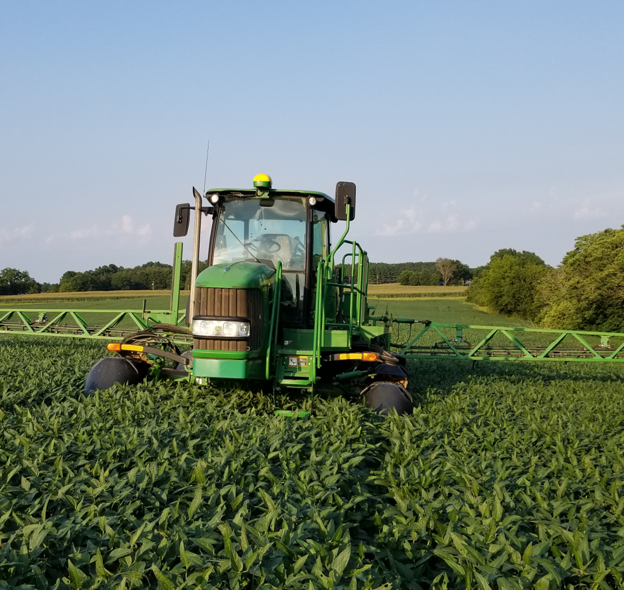
Herbicide Burndown
In the past, specific chemistry was needed to terminate mixed cover crop stands
Implications to next crop provided challenges of chemistry selection
Improved crop genetics allow for more termination tools
  Glyphosate tolerant
  Glufosinate tolerant
  Dicamba tolerant
  2-4D tolerant
  Doesn’t fit well in organic operations
Notes:
This will likely be in Candy’s presentation. May need to share slides with her. This presentation should build up to the next presentation on specific termination
This slide covers a topic that was of great concern back in 2007-08. Mixed specie cover crops required multiple herbicide modes to be able to terminate successfully. Those required herbicides could then impact the intended cash crop that was being planted into the cover crop. New technology traits in cash crops have aided in adoption of cover crops due to ease of termination of the cover crops with minimal impact to future cash crops.

Slide 43
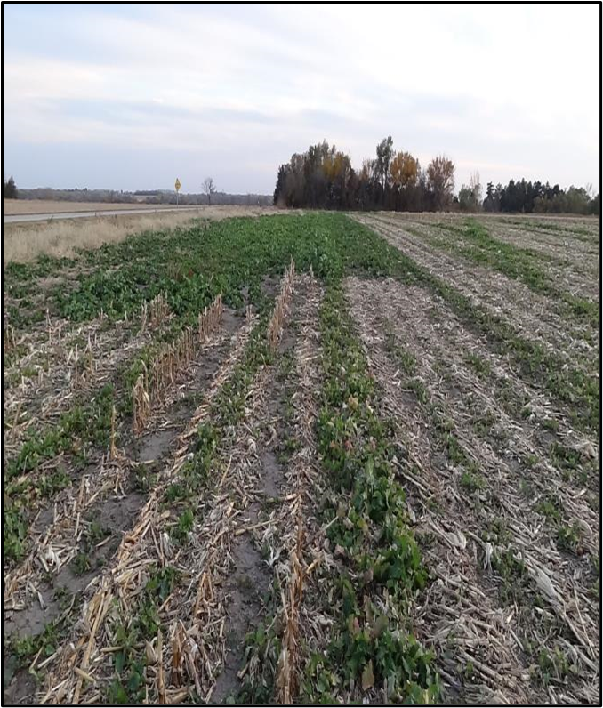
Cover Crop Herbicide Restrictions
Forage and grain (food chain)
  Herbicide must be labeled for all crops
  Rotation/plant back restrictions
  Forage restrictions (grazing, haying)
Cover only (soil building or erosion)
  At your own risk (some labels lack info)
  Review labels/experience
Climate & soils (biological activity)
Carryover potential
  Challenging to predict potential carryover of herbicides to cover crops with exhaustive variables.
  Careful planning can help increase confidence.
  When in doubt, perform a bioassay.
Notes:
There are several considerations to look at when planning or planting cover crops. Herbicide residuals could terminate desired species in cover crop mixes.

Slide 44

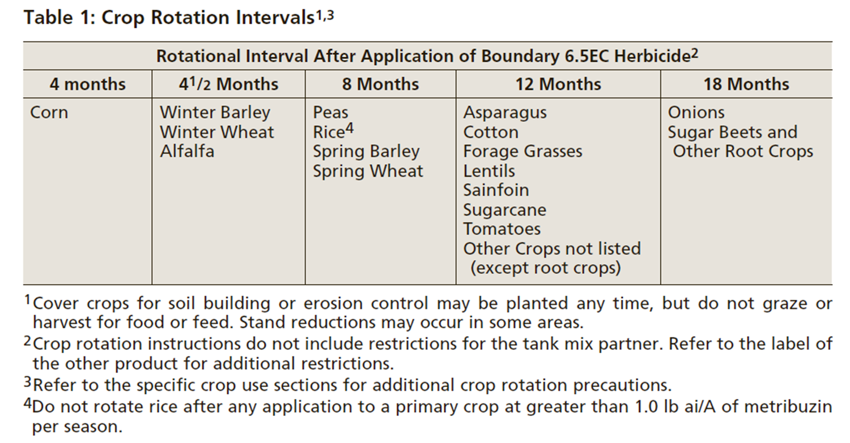
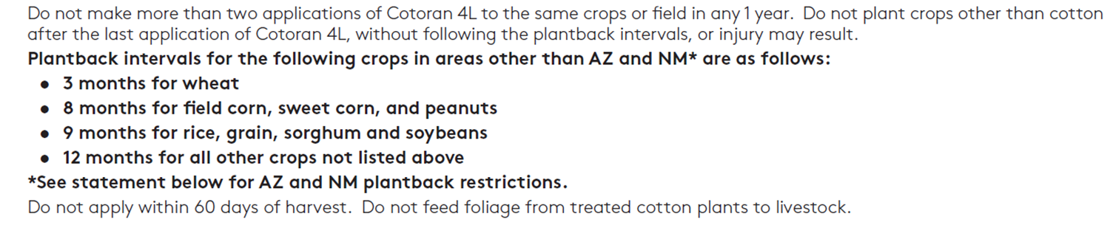
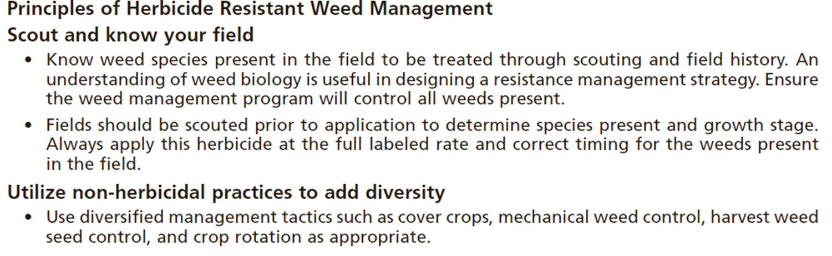
Herbicide Label Example
Notes:
Discuss these different sections of the example label and discuss the potential impacts that the herbicide could have on a planned cover crop planting. If needed, a substitute label could be entered into this slide to represent a common herbicide used in your area.

Slide 45
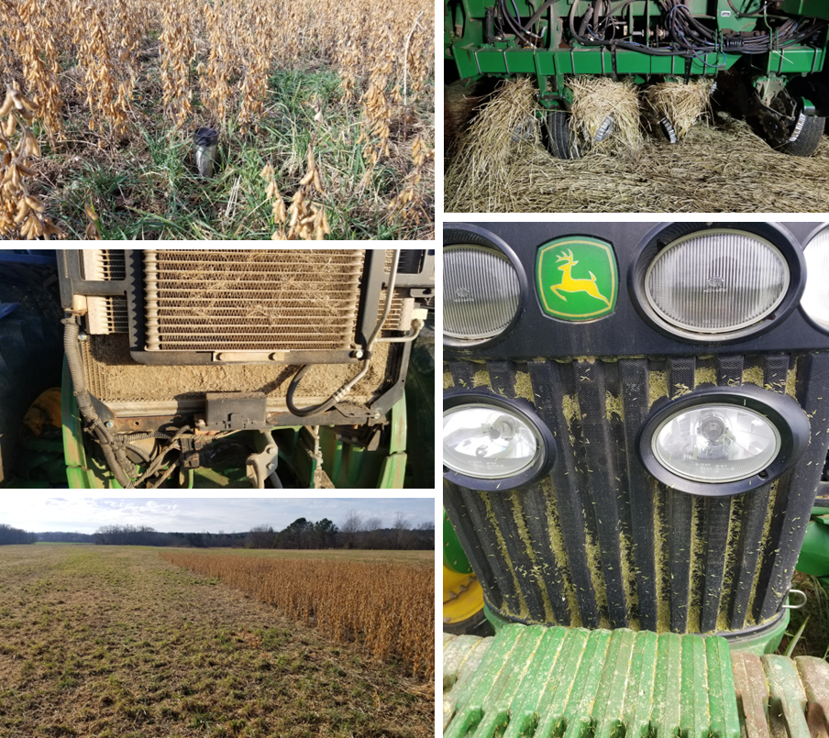
Plant a cover crop they said, It will be great they said!!!!!
Notes:
Photo Credit: Nathan Lowder SHD
Photo descriptions:
Top Left – volunteer cover crop in standing soybeans prior to harvest. The prior cover crop was terminated to late after viable seed had been produced. The volunteer cover crop could pose issues with cash crop harvest.
Left Center – the photo is of the radiator of a tractor that was being used to roll down cover crops that were in full bloom. Pollen is abundant and could potentially clog radiator and other cooling system components. Daily maintenance is required to keep equipment cleaned out to avoid issues. It usually is not a problem, just requires daily maintenance.
Bottom Left – Harvest of soybeans with cover crop that volunteered and emerged into cash crop. Excess green material could impact cash crop harvestability and grain sample quality
Top Right – Planter with cover crop residue wrapped around row cleaners on planting unit. This was caused by planting into rolled cover crop the opposing direction.
Bottom Right – Pollen and cover crop residue clogging screens on a tractor rolling cover crop. This could also be observed if producer was planting green.

Slide 46
Additional Cover Crop Planning Tools
State Specific Cover Crop 340 Practice Standard and Supporting Appendices
Cover Crop Council Specie Selector and Seeding Rate Calculators
Resources and Publications—Soil Health Division and Plant Materials Center Tech Notes
Various industry cover crop calculators
Notes:
Add notill farmer pulses and minuses. States can add additional local resources as needed

Slide 47
Thank you!
For more information on Managing Soil Health,
visit us here:
https://www.nrcs.usda.gov/conservation-basics/natural-resource-concerns/soils/soil-health
USDA is an equal opportunity provider, employer, and lender.

